Slide 1
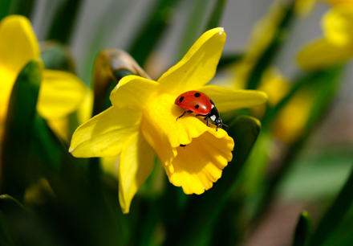
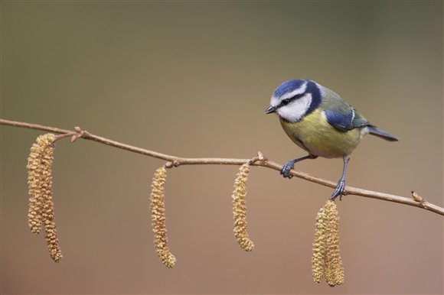
Fowlmere Bullfinches
Youth Group Event for
Ages 7 to 12
Signs of Spring
Fowlmere RSPB
Mill Road, Fowlmere, Cambridgeshire, SG8 7SH
Sunday 8th March
10am - 12.30pm
Come and explore the reserve looking for the emerging signs of spring!
Please email us at fowlmerebullfinches@hotmail.co.uk by Wednesday 4st March
to book your place. £2 members, £3 non-members

