Slide 1
Meet the Teacher – Y6
Mrs Dawson
Mrs Smith
MISS RUNHAM (MONDAYS)
PPA: MISS Karausta
2026/27

Slide 2
Key Information
Homework
out Friday/due Wednesday
Maths, English and Spelling
Reading expectations
20 minutes daily
PE
Thursday and Friday
Notes:
Key Information
You will already know through the smart blue jumpers that Year 6 have quite a few differences and privileges to the rest of the school. This is to match the maturity of the year group and prepare pupils for secondary school. Therefore Y6 pupils are required to complete homework each week. This will go out on a Thursday and be due in on a Wednesday.
Reading Expectations
Pupils should be reading at home for around 20 minutes a day.
Pupils all have a login to Read Theory where they can complete short comprehensions. Some weeks this will form part of homework.
PE
PE will be on a Tuesday and Wednesday this year. If there is a medical reason for your child not taking part in PE please inform the office via email.

Slide 3
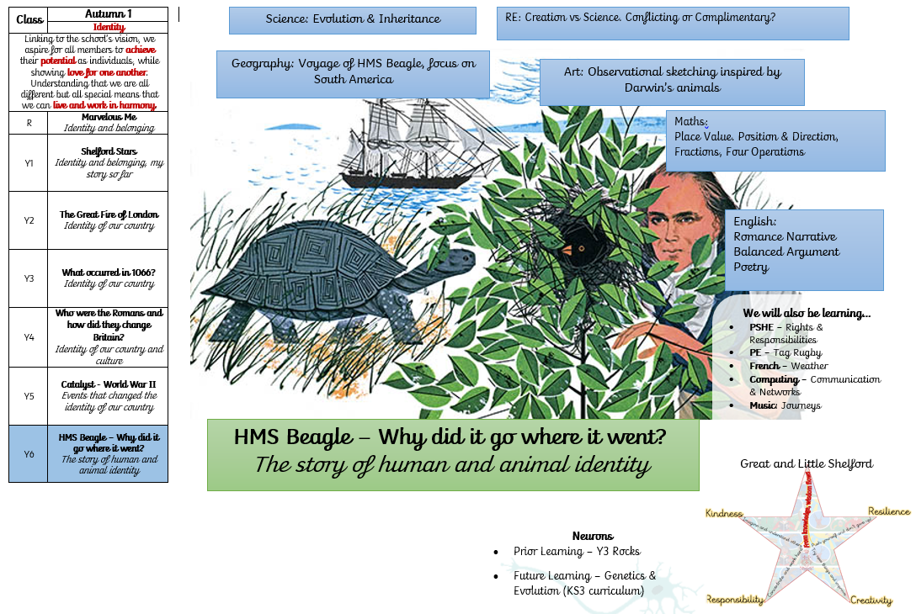
Notes:
Here is our overview for Autumn 1. Where we follow the school’s curriculum thread of identity. Our Key Question is: HMS Beagle, why did it go where it went? This is a science based topic looking at evolution and inheritance A different view of maths and English will be shared on the class page of the website.

Slide 4
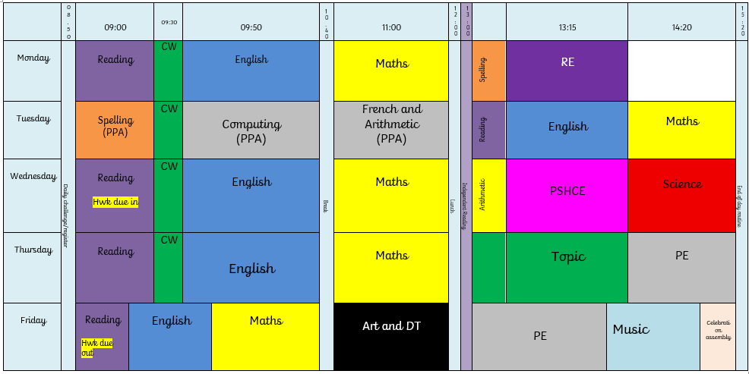
Weekly Timetable
Notes:
Here, you can see our general timetable. Most days, we start the day with spelling and reading, collective Worship and then English followed by Maths. The afternoons can vary for instance if we have a particular project on the go but PE will always be Tuesday and Wednesday.

Slide 5
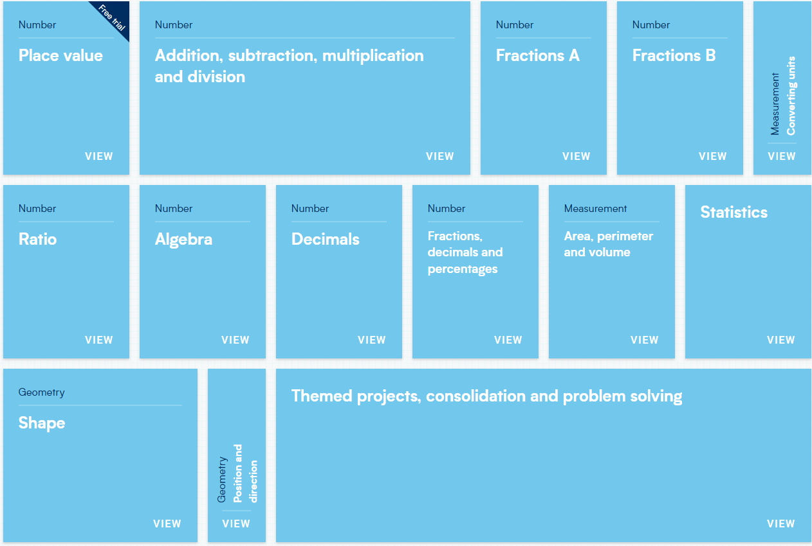
Maths

Slide 6

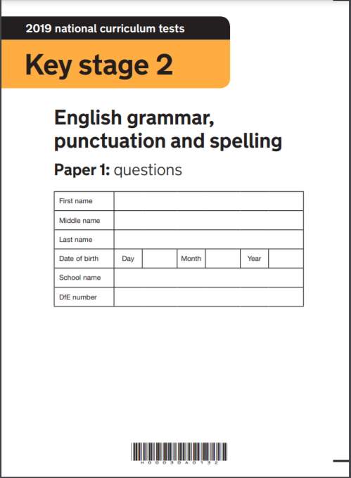
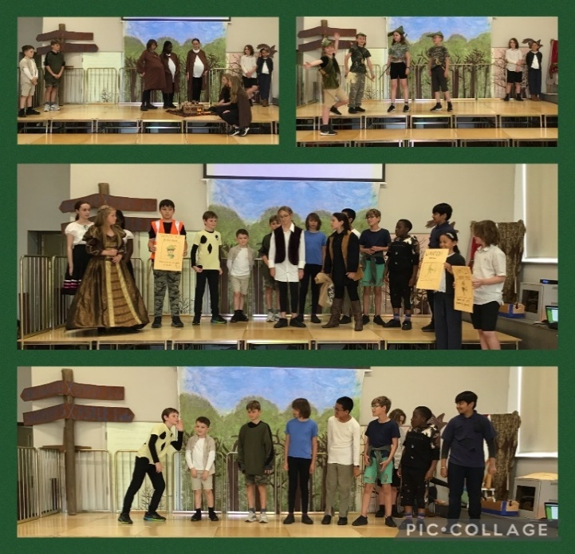
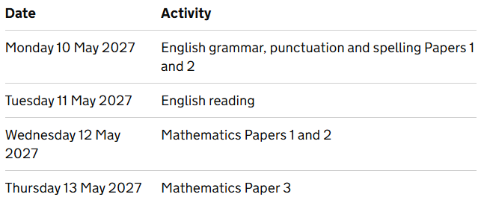
Diary Dates
SATS – week beginning 10th May
Grafham Water – 12th – 14th October 2026
Production 5th & 6th July
Leavers’ Service – 20th July
Notes:
Diary Dates
The residential to Grafham Water will be on Monday 11th March until Wednesday 13th March. There will be a parent session to answer specific questions and a kit list released nearer the time.
The summer term is a busy one for Year 6. Firstly, the pupils will sit the KS2 SATS. This will be in the week beginning 13th May. We will sit some mock SATS in the year but the majority of preparation will be through curriculum coverage in lessons. We then have great fun with the production and then prepare pupils for their Leavers’ service at the end of the year.

Slide 7
Thank you!
Urgent information and any other requests to be sent to the office at office@shelford.cambs.sch.uk
Notes:
Thank you for listening. As a reminder, non-urgent questions can be sent to the class email at year6@shelford.cambs.sch.uk
Any urgent information and items needing to be seen the same day need to be sent to office@shelford.cambs.sch.uk

