Slide 1
November 2020
Welcome! As we are now heading into another lockdown due to the pandemic, it’s important we remain in contact with our school community to continue delivering key safety and awareness messages to keep you and your families knowledgeable and safe during these unsettled times.
Knife Crime awareness week of action
9th – 15th November 2020
Operation Sceptre (#operationsceptre) is a National Campaign to target knife related crime by raising awareness amongst communities and to encourage everyone to understand the risks and how you can help to reduce these offences and keep people safe. During the Week of Action, or over coming weeks, your child may receive a presentation in school which highlights the risks and consequences and how they can keep themselves and others safe by reporting any concerns. There will also be advice, updates and key messages posted via the Cambridgeshire Constabulary Facebook, Twitter and Instagram pages – please take a look next week;
@cambscops @cambscops Cambscops
THE DANGERS – whilst a small minority of young people may feel tempted or pressured to carry a knife/weapon for what they believe to be ‘self protection’, it is important for them to know this significantly increases the risk of harm to them.
THE FACTS – the Police can stop and search anyone they have reasonable grounds to suspect to be carrying a knife or other offensive weapons.
THE LAW – it is illegal to carry a bladed article in a public place – the maximum penalty for carrying a knife is 4 years in prison and an unlimited fine. It is also an offence for retailers to sell knives to under 18’s.
THE CONSEQUENCES – a criminal record can change your life – it may prevent you getting certain employment in the future and it can prevent travel to some countries.
Please watch this short video, a father and son wanted to deliver a short message on how to deal with a knife confrontation. *Parents/guardians/carers you may feel the content is not relevant or suitable for your child. This video is primarily targeting secondary school aged children. Please view before showing your child if they are primary school aged. There is no swearing or injury detail*
hwttps://ww.instagram.com/p/CEbmbsOHxMS/?igshid=vcjt4sbyjur3
There is no shame in running away from a situation and it could save your life and stop someone else ruining theirs by making one fatal mistake. If you know someone who carries a knife, call us on 101
For further information please visit www.cambs.police.uk
#SaferCambs
Call: 101
Telephone: 18001 101 Visit: cambs.police.uk Follow: CambsCops
Subscribe: eCops.org.uk

Slide 2
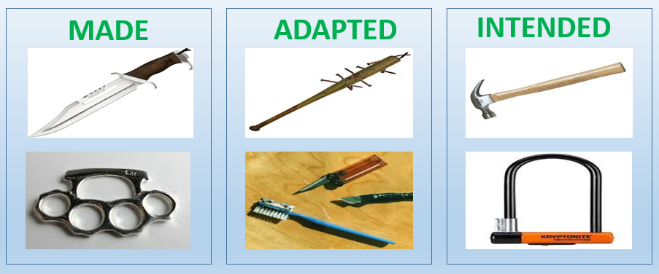
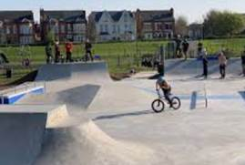
November 2020
The law – Offensive Weapons
It is against the law to be in possession of an offensive weapon
which has been made, adapted or intended to be used to cause
injury in a public place.
The law can be quite complicated, however it is really important you understand what it means so you can make the right choices.
What is an offensive weapon ? A weapon is any article (item) MADE, ADAPTED or INTENDED for causing injury.
MADE are those which are already manufactured for that purpose – so knives, knuckle dusters and some martial arts weapons such as nun chucks fall into this category.
ADAPTED can be ordinary items that have been altered to make them suitable for causing injury (for example a blade fixed to a toothbrush).
INTENDED can be innocent items that have another use, but are then taken and used as a weapon (for example, bike locks, screwdrivers & tools).
So, if you are found in possession of these items, in a public place, you may be committing a criminal offence.
Public place?
A public place is any location where the public have access to and have the freedom to come and go. Examples being
Shops / Shopping arcades, Sporting venues / Cinemas, Parks and recreational grounds.
It is also important to know that Schools and Colleges are considered to be a Public Place in relation to the law and weapons. The Police and school staff have the power to search anyone (including bags/lockers) and school premises and playing fields if there is suspicion that weapons are being concealed.
Call: 101
Telephone: 18001 101 Visit: cambs.police.uk Follow: CambsCops
Subscribe: eCops.org.uk
#SaferCambs

Slide 3
November 2020
Anti-Bullying week, gives us all the opportunity to place a spotlight on bullying and consider the steps we can take together to help stop it! Get involved and support Anti-Bullying week.
On the first day of the campaign Monday 16th November, its ODD SOCK DAY!!
Wear odd socks to school or work, or even just at home to highlight that it is OK to be different. *Please remember to check with your school and/or employer that this is acceptable.
The Anti-Bullying Alliance and its members work with children, families and schools to help keep children safe. For more information on other activities for Anti-Bullying week or if you are worried about bullying and need some advice or support, click on this link www.Anti-bullyingalliance.org
Remain safe this Guy Fawkes night!
With the strict government restrictions now in place, firework celebrations will be very different this year with public displays cancelled due to Covid. If you are planning a small family ‘bubble’ lockdown firework display at home please remember to follow the FIREWORK CODE to ensure the safety of all involved. Whilst fireworks are a tradition for this time of year, please also remember the impact the loud noises/flashes can have on animals. Please be courteous and advise any neighbours of your plans (note through the door) so they have time to get their pets inside and try and keep them safe and reassured.
Only adults should deal with setting up firework displays, the lighting of fireworks and the safe disposal of fireworks once they have been used.
Children and young people should be supervised at all times, and watch and enjoy fireworks at a safe distance.
Only buy fireworks which carry the CE mark, keep them in a closed box and use them one at a time.
Light the firework at arm's length with a taper and stand well back.
Keep naked flames, including cigarettes away from fireworks.
Never return to a firework once it has been lit.
Don't put fireworks in pockets and never throw them.
Direct any rocket fireworks away from spectators.
Never use paraffin or petrol on a bonfire.
Make sure that the fire is out and surroundings are made safe before leaving.
and finally…..remember, alcohol and fireworks do not mix !!
Click on this link for further safety information on fireworks and bonfires:
https://www.rospa.com/Home-Safety/Advice/Fireworks-Safety
We would love to hear your feedback & comments. You can contact the team via our email Schools&CYP@cambs.pnn.police.uk
Call: 101
Telephone: 18001 101 Visit: cambs.police.uk Follow: CambsCops
Subscribe: eCops.org.uk
#SaferCambs

